Slide 1





Karate API Testing Tutorial
Pramod Dutta Lead SDET.
Karate DSL,JSON & Setup Framework

Slide 2
What is JSON
Full Form - Javascript Object Notation
JSON Object : {}
JSON Array : []
A key and value pair.
Simple JSON - { “key” : “value”}
Comple : { “key” : {
“Key2” : “value”
}, “keyArray” : [ { “apple” : “fruit”}, {“banana”: “fruit”}]
}
https://www.w3schools.com/js/js_json_intro.asp

Slide 3
JSON Finder & JSON Data Types
Demo Of JSON
https://jsonpathfinder.com/
String
Number
Boolean
Null
Array
Object
https://www.w3schools.com/js/js_json_datatypes.asp

Slide 4

Why API Testing?
Millions of Web Apps and Mobile Applications use APIs.

Slide 5
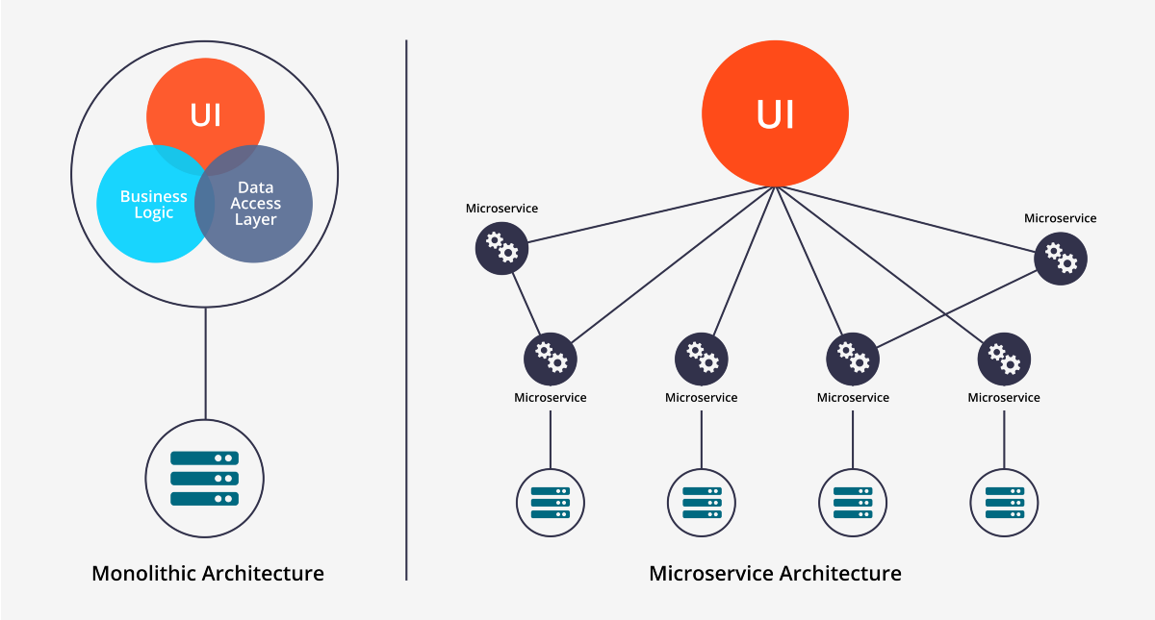
Why API Testing?
MicroServices Architecture.

Slide 6
Microservices
Architectural style that structures an application as a collection of services
Highly maintainable and testable
Loosely coupled
Independently deployable
Organized around business capabilities
Owned by a small team Read more - https://microservices.io/

Slide 7
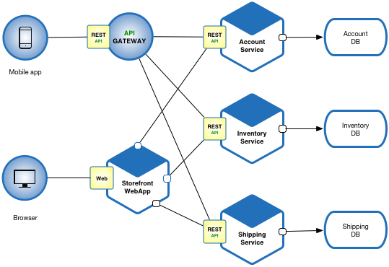
Microservices

Slide 8
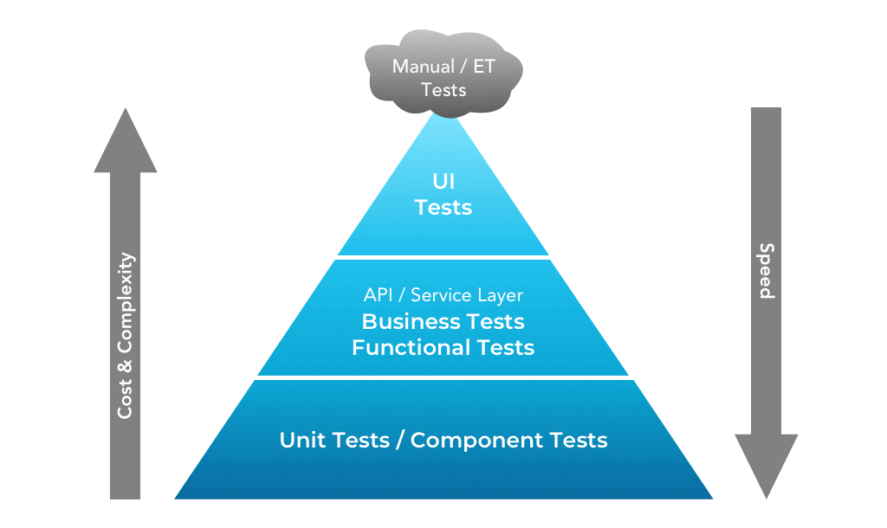
Why API Testing?
Why API Testing?
.UI Testing is costly.
API Testing is easy and can caught early Bugs.

Slide 9
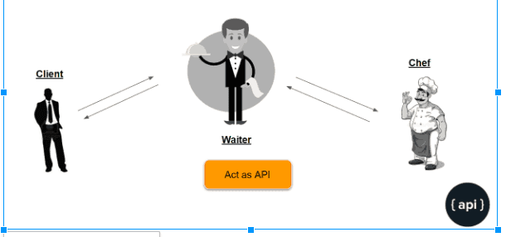
What is API ?
API stands for the Application Programming Interface,

Slide 10
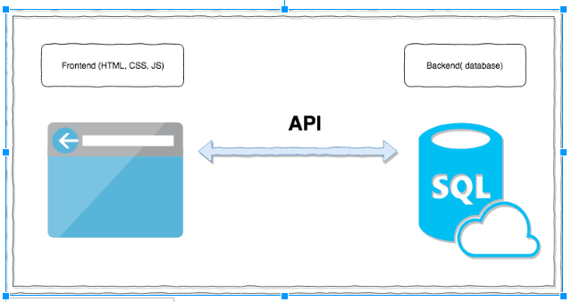
What is API ?
Basically a collection of functions and procedures which allows us to communicate two applications or libraries.

Slide 11
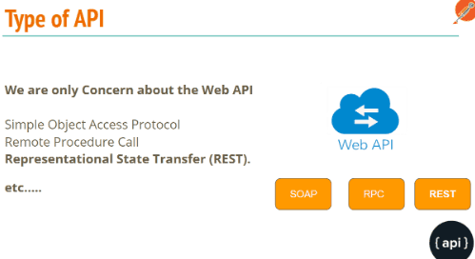
Type of APIs :
We are going to Learn REST API Testing.

Slide 12
What is REST API?
REST is an acronym for REpresentational State Transfer.
The REST architectural style describes six constraints.
These constraints, put on the architecture, were initially communicated by Roy Fielding in his doctoral dissertation and defines the basis of RESTful-style.

Slide 13
What is REST API?
In Simple Terms REST API is nothing but a Design Pattern for Web API

Slide 14
REST Constraints
Uniform Interface
Stateless
Cacheable
Client-Server
Layered System
Code on Demand
https://scrolltest.com/rest/explained

Slide 15
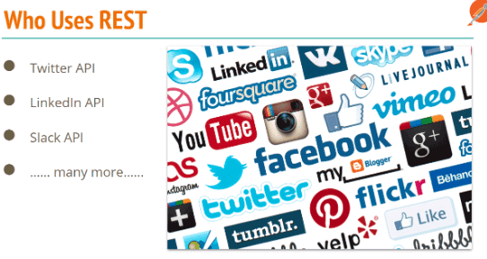
REST Used by ….
Most of WebApps, Mobiles are relying on REST API

Slide 16
What To Test in APIs?
Verify the Parses JSON or XML response.
HTTP Status Code.
Verify Headers response with Negative or invalid headers.
Max/ Min Key values.
Have a test case to do XML, JSON Schema validation.
Verify that how the APIs error codes handled.
Missing Keys
Empty Updates or POST call handling.
Chaining request verification.
End to End Crud.
Database integrity test
File upload.

Slide 17
What is Test in APIs?
Test nulls and empty strings, these have a habitat of causing issues ;).
Test with Unicode characters, ensure they are correctly saved to the database.
Test mandatory and optional parameters, in particular test with just mandatory values.
Ensure correct status codes are returned, you will find false positives e.g a 500 being returned as a 200.
Functionality Bugs: the test looks for missing functionality bugs
Reliability Bugs: API testing helps identify bugs pertaining to integration across different systems
Performance Bugs: The tests help determine how much traffic the system can handle before being overloaded, and how to expand infrastructure to meet rising demand at the core, but also are very effective at pinpointing weak points in the API
Security Bugs

Slide 18
What is Test in APIs?
Boundary Value Analysis (BVA)
Equivalence Class Partitioning
Decision Table based testing
Error Guessing
State Transition

Slide 19
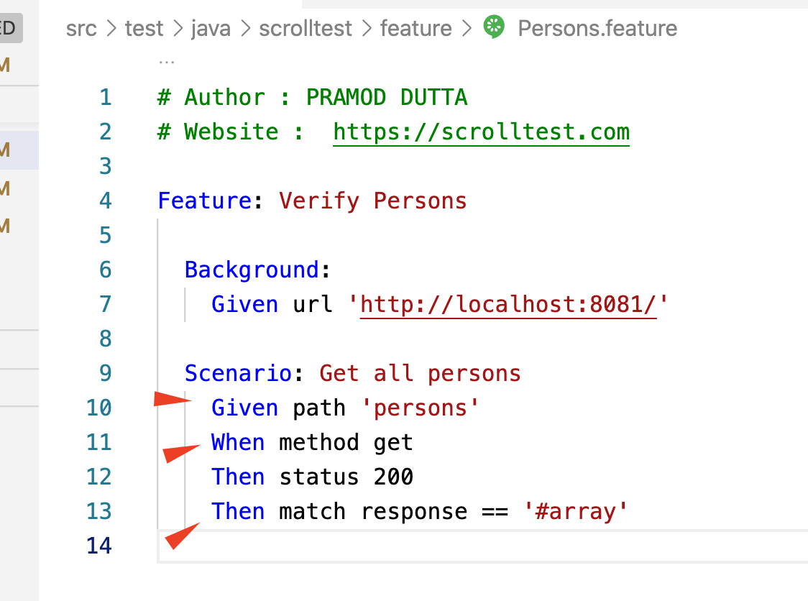
Karate Files
Like Cucumber Feature Files with Gherkin Syntax.

Slide 20
Karate Framework Components
Feature Folder
POM.xml
Runner Java File
Logging - Logback.xml config
Config Management - Karate Config.xml Misc - Helper Java/ JS in Helper folder.

Slide 21
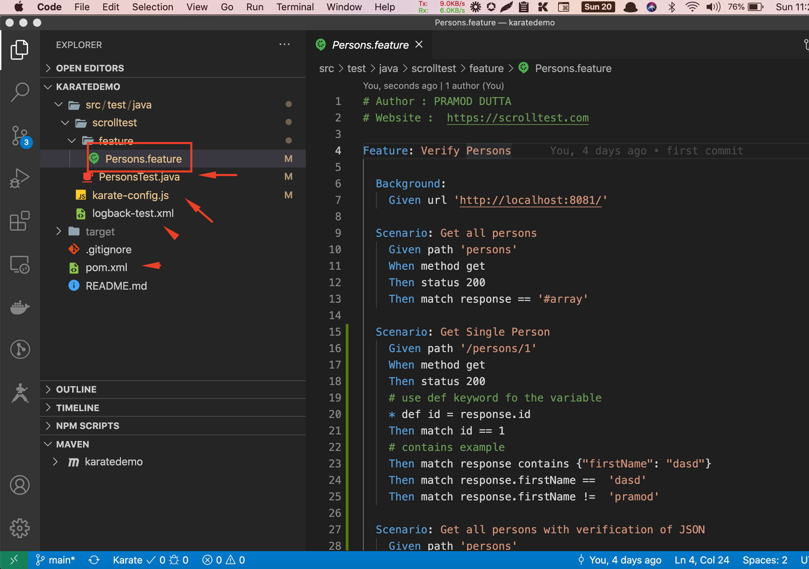
Set up the Karat Framework

Slide 22
Simulate GET All Person, Get Single Person
Demo Now
Person Feature Download - https://pastebin.com/kb85efmJ
Runner for the Person Java - https://pastebin.com/vE0BQiWJ
Karate StartKit - https://apitesting.co/2cKG

